Slide 1
AI Trainer for Bicep Curls
J067
Sushmit Kadam

Slide 2
Problem Definition
Challenge: Precision in maintaining proper form during strength training exercises is paramount for their effectiveness and injury prevention.
Need: There's an imperative need for a solution that provides real-time feedback on both form and speed, optimizing workout effectiveness and ensuring safety.

Slide 3
Proposed Solution
Project Objective: To develop a sophisticated AI-powered fitness application for real-time form assessment during bicep curls.
Key Features:
- Pose Estimation: Leveraging the powerful Mediapipe library for precise tracking of shoulder, elbow, and wrist positions.
- Feedback Mechanism: Providing intuitive visual cues and real-time messages to guide users, ensuring correct posture and pace.
- Repetition Counting: Implementing an intelligent system to accurately count repetitions, enabling users to track their progress.
- User Interface: Offering an intuitive, user-friendly interface to enhance engagement and motivation.

Slide 4
Setup and Libraries Used
Libraries:
- OpenCV: Essential for image and video processing, capturing frames, and enabling real-time image manipulation.
- Mediapipe: Empowering the application with human pose estimation capabilities, ensuring precise tracking of key joints.
- NumPy: Facilitating efficient numerical operations for angle calculations and array manipulations.
- Streamlit: Enabling seamless deployment of the application through an interactive and user-friendly web interface.

Slide 5
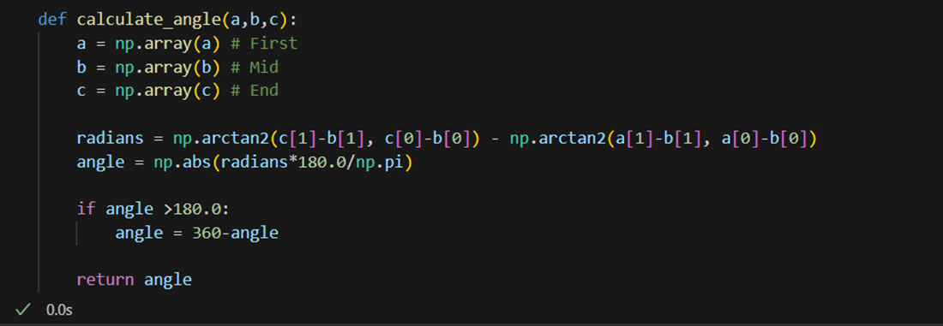
Calculating Angle
This segment defines a function calculate_angle that computes the angle between three points using trigonometric calculations. This function is used to determine the angles at the shoulder, elbow, and wrist joints during the bicep curl exercise.

Slide 6
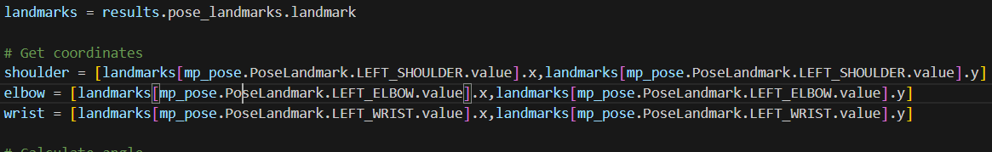
Pose Landmark Extraction:
This part of the code extracts landmark coordinates for the left shoulder, elbow, and wrist joints from the processed pose results.
Using the calculate_angle function, the joint angle for the bicep curl is computed based on the positions of the shoulder, elbow, and wrist joints.

Slide 7
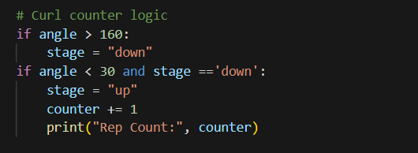
Bicep Curl Detection Logic:
These lines implement the logic for counting repetitions. When the angle is greater than 160 degrees, the exercise is in the "down" stage. If the angle falls below 30 degrees and the exercise was in the "down" stage, it is considered a complete repetition, and the counter is incremented.

Slide 8
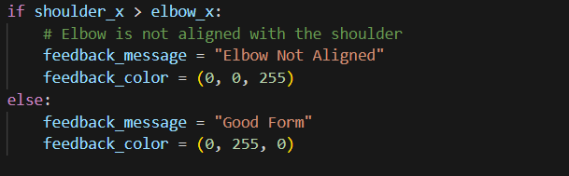
Feedback Message
Based on the alignment of the shoulder and elbow (evaluated by comparing their x-coordinates), feedback messages are set to indicate whether the user's form is correct or if the elbow is not properly aligned with the shoulder.

Slide 9
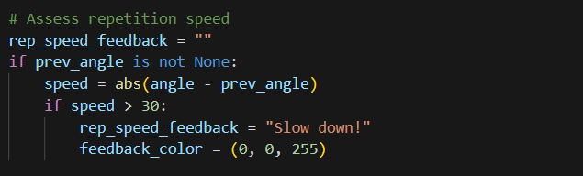
Repetition Speed Feedback:
The code calculates the speed of angle change between frames. If the speed exceeds a threshold (30 degrees), it provides feedback to slow down, indicating that the user is performing the bicep curl too quickly.

Slide 10
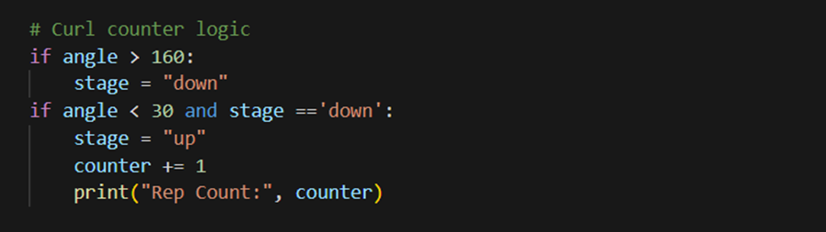
Curl Counting
These lines implement the logic for counting repetitions. When the angle is greater than 160 degrees, the exercise is in the "down" stage. If the angle falls below 30 degrees and the exercise was in the "down" stage, it is considered a complete repetition, and the counter is incremented.

Slide 11
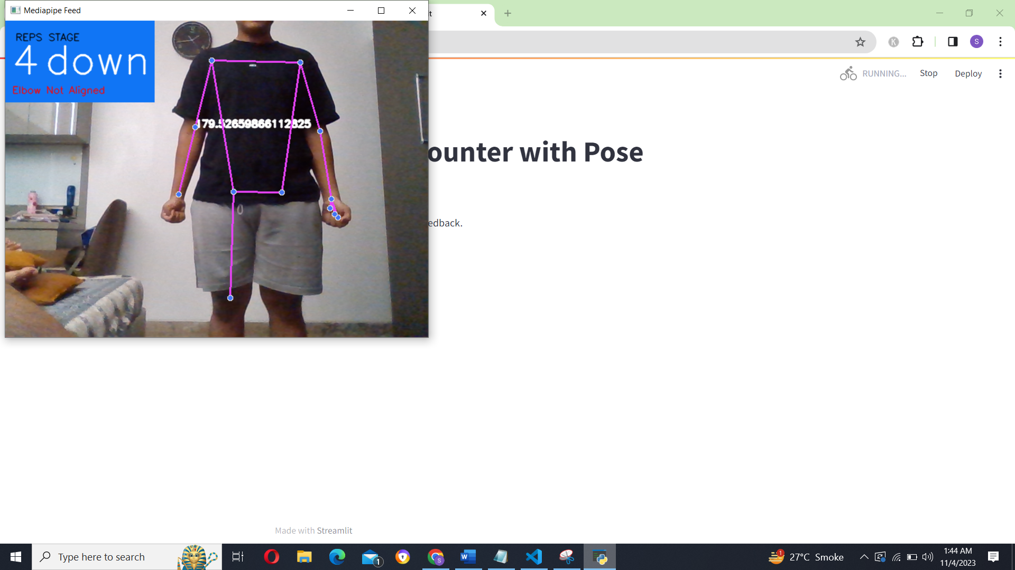
Live Working

Slide 12
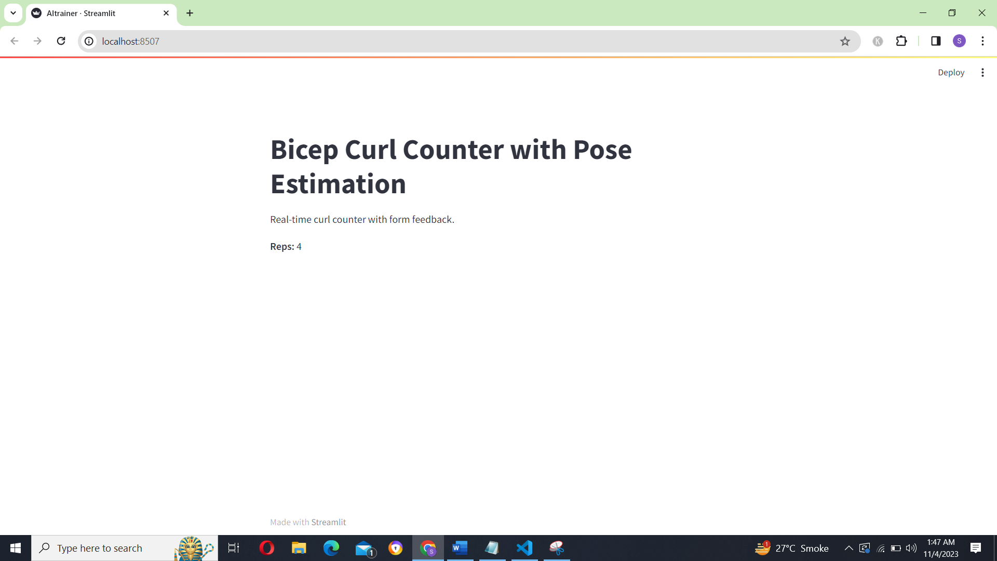
Output

Slide 13
Scope of the Project
Current Implementation: The system is tailored for assessing bicep curls, providing real-time feedback on form and repetition speed, laying the foundation for comprehensive fitness support.
Future Scope:
- Multi-Exercise Support: Expanding the application to encompass a variety of strength training exercises, catering to diverse fitness needs.
- Personalization: Allowing users to create and personalize workout routines, fostering a tailored fitness experience.
- Mobile Application: Developing a dedicated mobile app version to enhance accessibility and introduce additional features.
- Data Analytics: Implementing advanced data analysis techniques to offer valuable insights, aiding users in optimizing their workout routines.
- Virtual Trainer: Integrating natural language processing capabilities to enable interactive communication and respond to form-related queries.

Slide 14
Conclusion
Achievements: Successful development of an AI Trainer delivering real-time feedback on bicep curls, significantly enhancing user experience and ensuring safety.
Impact: Pioneering a revolution in fitness technology, making it accessible, engaging, and highly beneficial for users of all fitness levels.
Future Prospects: With the continual advancement of technology, applications like AI Trainer are poised to transform the fitness industry, promoting holistic health, wellness, and highly personalized training experiences.

Slide 15
References
[1] https://www.youtube.com/watch?v=H7cGq0xIHbc
[2] https://www.youtube.com/watch?v=PGsAsuwBdw0
[3] https://medium.com/ai-techsystems/image-detection-recognition-and-image-classification-with-machine-learning-92226ea5f595#:~:text=Image%20or%20Object%20Detection%20is,the%20difference%20is%20rather%20clear.
[4] https://viso.ai/computer-vision/image-recognition/
[5] https://www.freecodecamp.org/news/how-to-detect-objects-in-images-using-yolov8/

